Slide 1

Messaging Web Application Using High-Speed Encryption Algorithm with Polynomial Roots
InTouch

Slide 2
Team Members:
Mohamed Ahmed Elsayed
Mohamed Abdelfattah Ahmed
Abdelfattah Zakaria Abdelfattah
Shrouk Elsayed Mohamed
Dalia Abdallah Mohamed
Sara Reda Abdallah
Under supervision of
Dr. Sayed Badr

Slide 3
Agenda
Problem Definition
Project Idea
Root Finding Algorithms
How Does Our Encryption Algorithm Works
Results
Current Solutions in the Market
Methodology
Current Progress
Future Work

Slide 4
Problem Definition
The current encryption algorithms are slow and consume a lot of energy, which is not suitable for real-time applications. They can cause multiple problems like:
Increased Processing Overhead.
Impact on Real-Time Systems.
Increased energy consumption and carbon footprint.

Slide 5
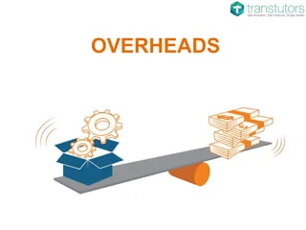
1- Increased Processing Overhead
Slower encryption algorithms require more computational resources (such as CPU cycles and memory) to perform encryption and decryption operations. This increased processing overhead can strain system resources, leading to higher costs, reduced scalability, and potentially degraded user experience.

Slide 6
2-Impact on Real-Time Systems
In real-time systems where timely processing is critical (e.g., communication systems, financial transactions), slow encryption algorithms may introduce unacceptable delays, affecting the responsiveness and reliability of the system.

Slide 7
3-Increased energy consumption and carbon footprint
In large-scale deployments, the high computational demand of complex algorithms can contribute to increased energy consumption and carbon footprint.
This poses ethical and environmental concerns.

Slide 8
Project Idea
Our project aims to develop a novel encryption algorithm based on polynomial roots, focusing on achieving both high speed and strong security. The goal is to surpass existing encryption algorithms, such as AES, in terms of speed. Additionally, we plan to create a web application that utilizes our algorithm to securely and swiftly transmit messages over networks by encrypting and decrypting them.

Slide 9
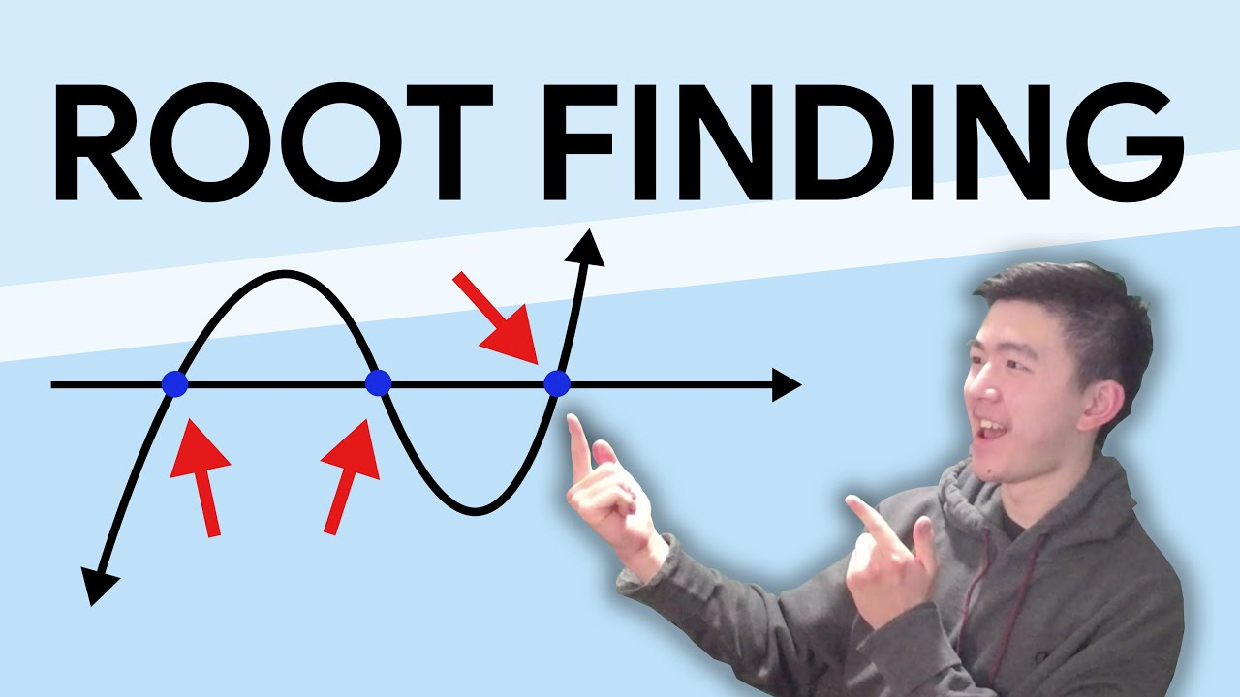
Root Finding Algorithms
Before talking about our solution ,let's talk about the base of our algorithm which is root finding algorithms. Root finding algorithms are used in many applications, like machine learning to solve optimization problems, in computer graphics, in economics and finance, and in cryptography. Here we use the root finding algorithms in cryptography.

Slide 10
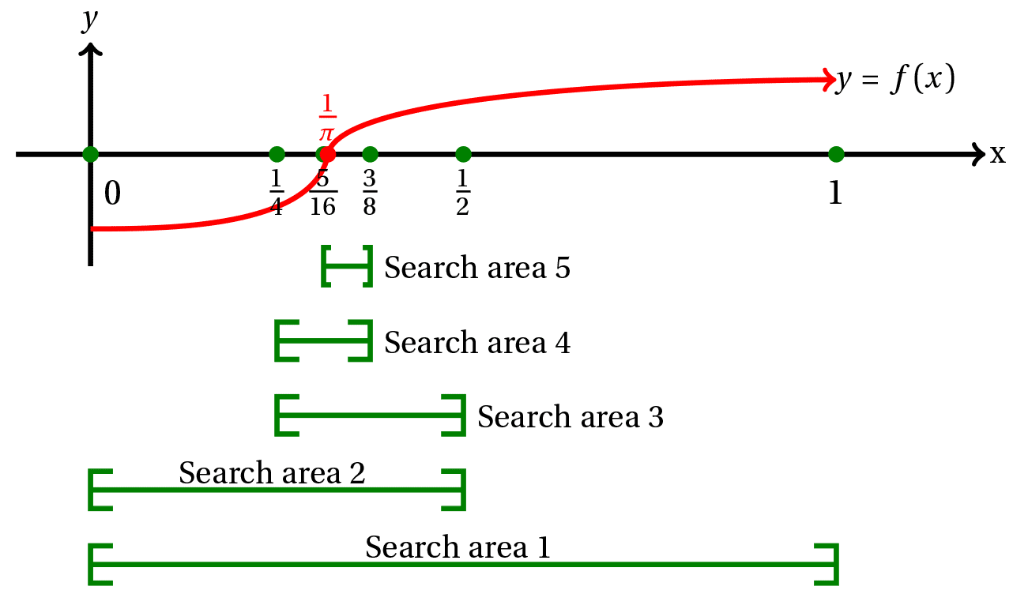
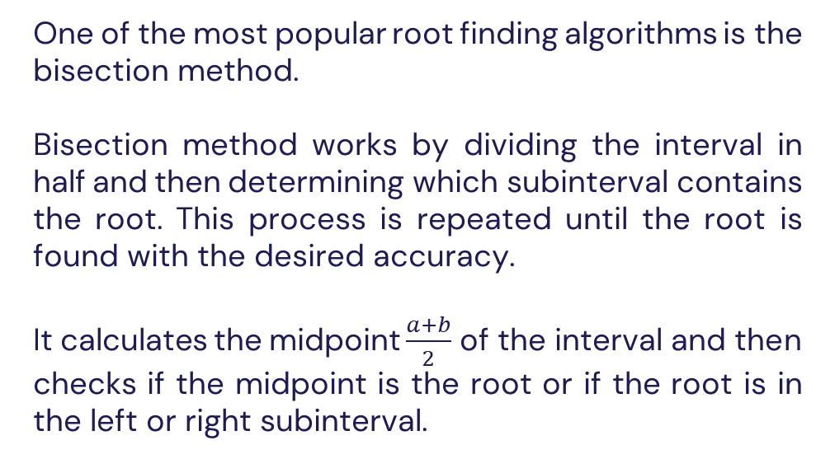
Bisection Method
One of the most popular root finding algorithms is the bisection method.
Bisection method works by dividing the interval in half and then determining which subinterval contains the root. This process is repeated until the root is found with the desired accuracy.
It calculates the midpoint $\frac{a+b}{2}$ of the interval and then checks if the midpoint is the root or if the root is in the left or right subinterval.

Slide 11
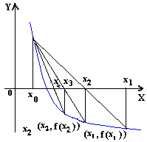
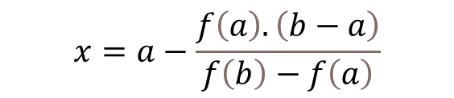
False Position Method
Another root finding algorithm is the false position method.
The false position method is similar to the bisection method, but instead of dividing the interval in half, it uses a linear interpolation to determine the next approximation of the root.
The successive estimates, from the following
relationship:
$$x=a−\frac{f\left(a\right).\left(b−a\right)}{f\left(b\right)−f\left(a\right)}$$

Slide 12
HybridBF Algorithm
The HybridBF algorithm is a root finding algorithm that combines the bisection method and the false position method to improve the convergence speed and accuracy of root finding.
We have tested this algorithm against both bisection and false position and it has shown to be faster and more accurate.
It Works by using the bisection and false position methods in parallel and then selecting the best approximation of the root from the two methods.

Slide 13
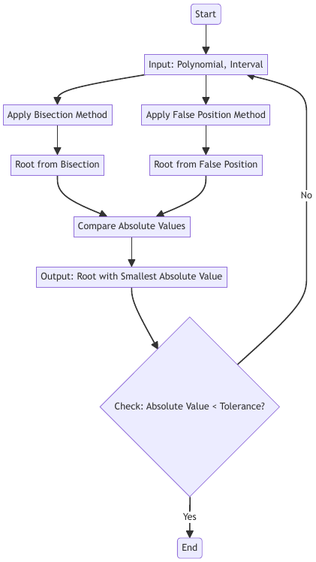
Hybrid Algorithm Flowchart

Slide 14
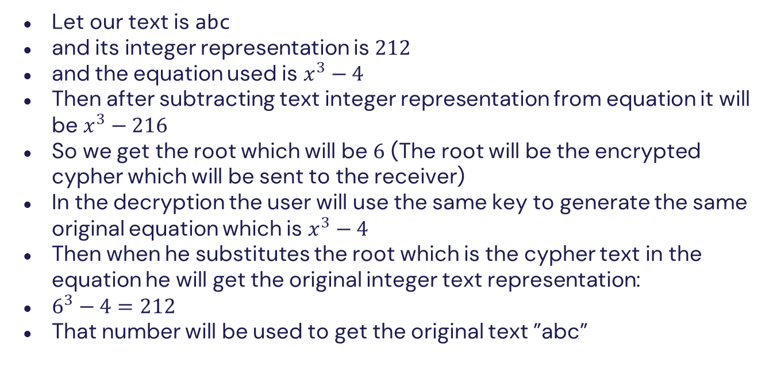
Example (No Normalization for Simplicity)
Let our text is abc
and its integer representation is $212$
and the equation used is $x^{3}−4$
Then after subtracting text integer representation from equation it will be $x^{3}−216$
So we get the root which will be $6$ (The root will be the encrypted cypher which will be sent to the receiver)
In the decryption the user will use the same key to generate the same original equation which is $x^{3}−4$
Then when he substitutes the root which is the cypher text in the equation he will get the original integer text representation:
$6^{3}−4=212$
That number will be used to get the original text ”abc”

Slide 15
Compare Results
We have compared the performance of the HybridBF algorithm with the bisection and false position methods using a set of benchmark functions and the results show that the HybridBF algorithm outperforms both bisection and false position in terms of convergence speed and time, number of iterations, and accuracy.

Slide 16
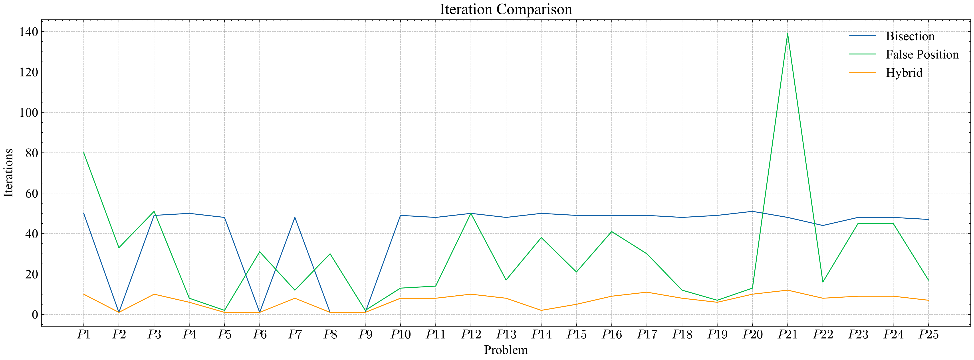
Number of Iterations

Slide 17
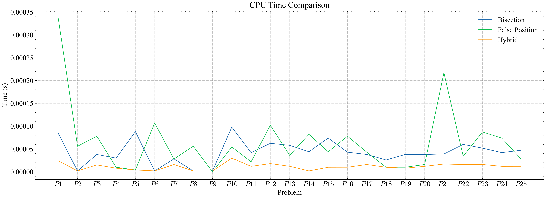
CPU Time

Slide 18
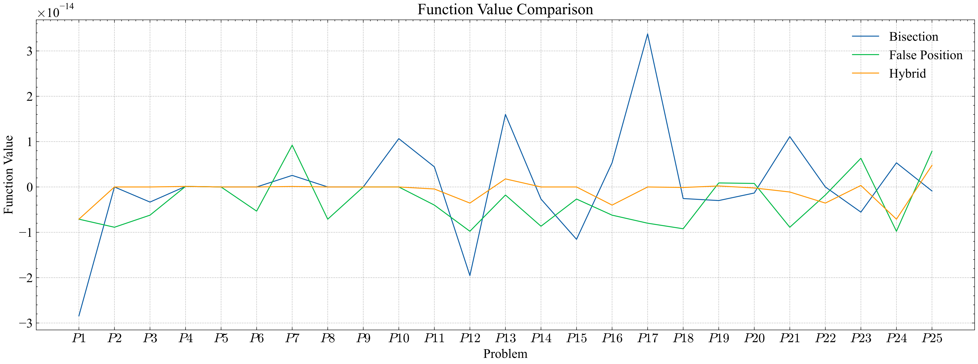
Function Value

Slide 19
How Does Our Encryption Algorithm Works
The algorithm is based on the roots of a polynomial. The roots of a polynomial are the values of that make the polynomial equal to zero. The algorithm uses these roots to perform encryption and decryption operations. The algorithm accepts a plaintext message and a key as input that will be used to generate a polynomial and produces a ciphertext message as output. The ciphertext is the root of that polynomial that can be decrypted to recover the original plaintext message.

Slide 20
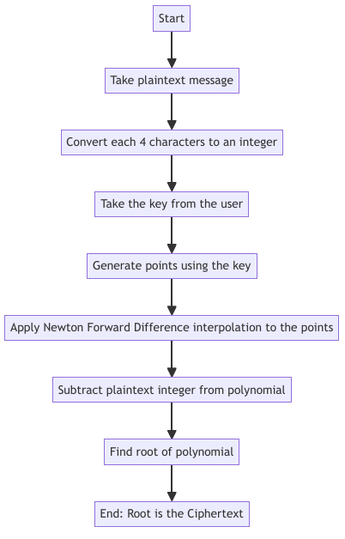
Encryption Process

Slide 21
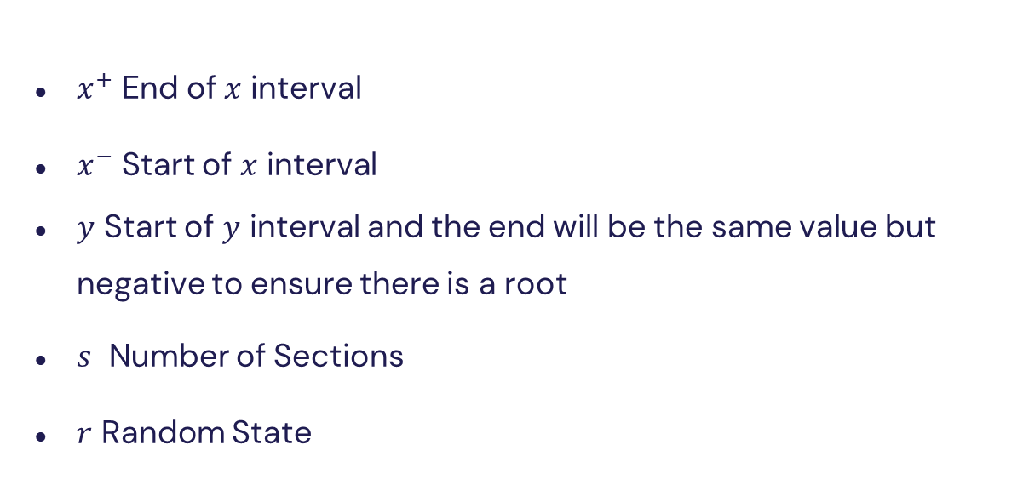
Key Numbers
$x^{+}$ End of $x$ interval
$x^{−}$ Start of $x$ interval
$y$ Start of $y$ interval and the end will be the same value but negative to ensure there is a root
$s$ Number of Sections
$r$ Random State

Slide 22
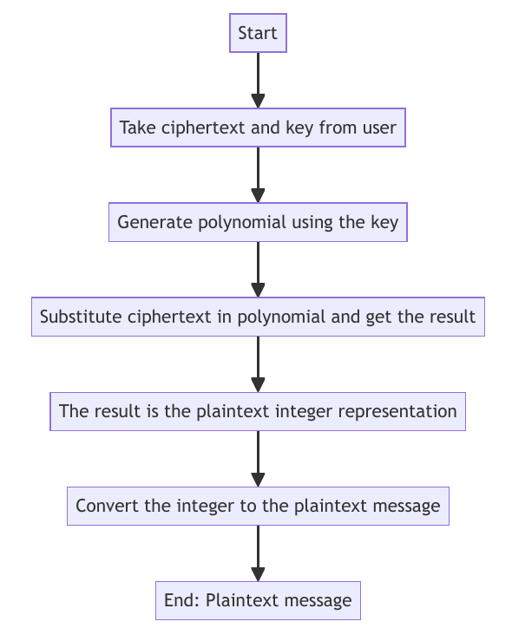
Decryption Process

Slide 23
Results
The algorithm was tested using different plaintext messages and keys and was compared against AES encryption algorithm which is a symmetric encryption algorithm. The results showed that the algorithm is much faster than AES.

Slide 24
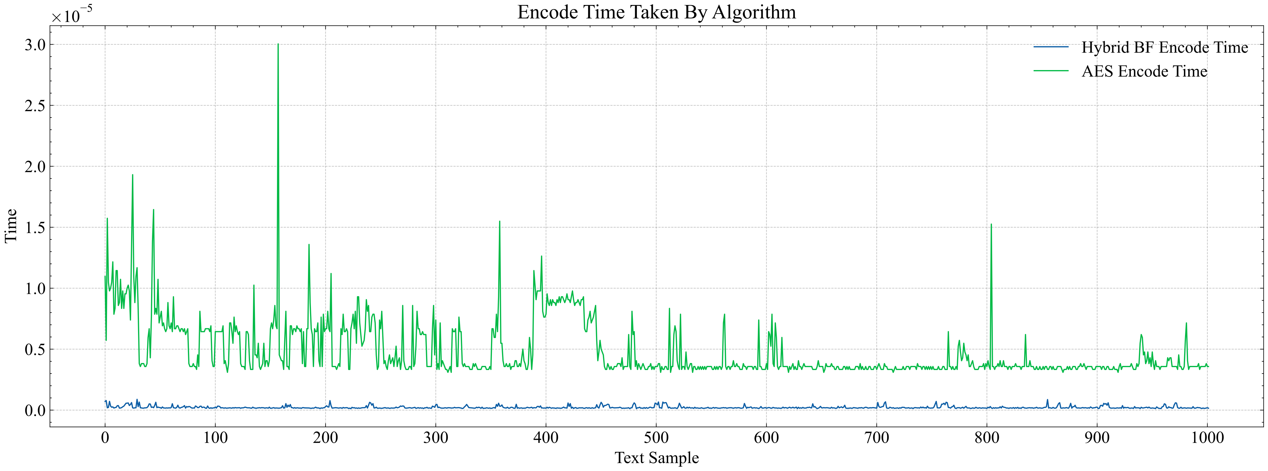
Encode Time Over 1000 Messages

Slide 25
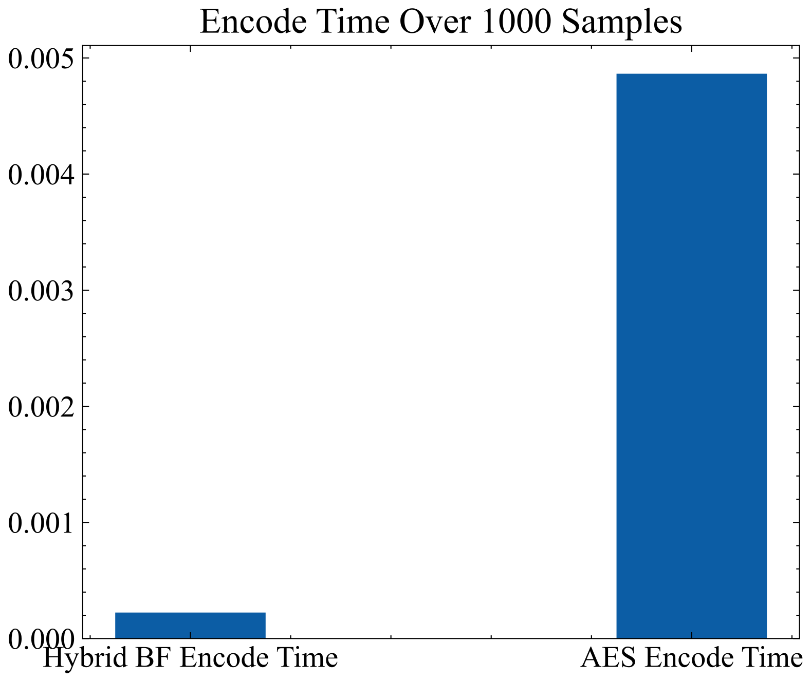
Encode Time Sum Over 1000 Messages
HybridBF broved to be 20 faster in total time

Slide 26
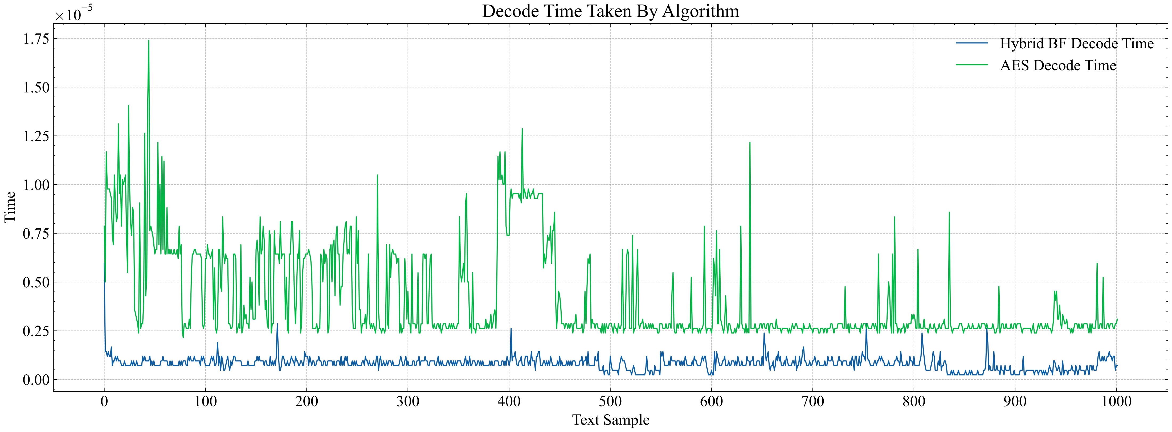
Decode Time Over 1000 Messages

Slide 27
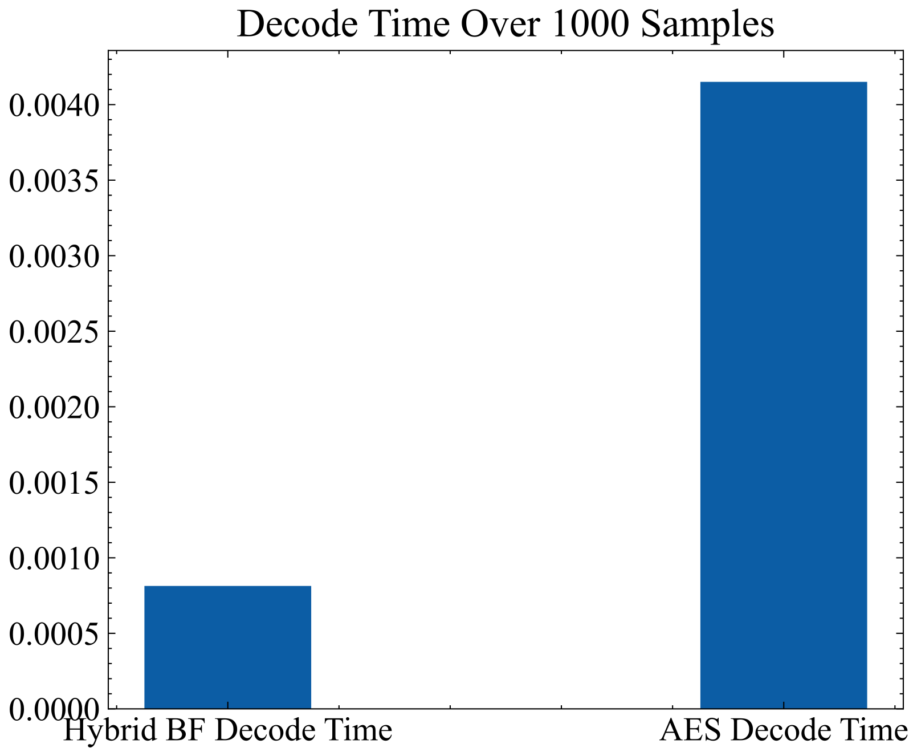
Decode Time Sum Over 1000 Messages
HybridBF broved to be 8 faster in decode time

Slide 28
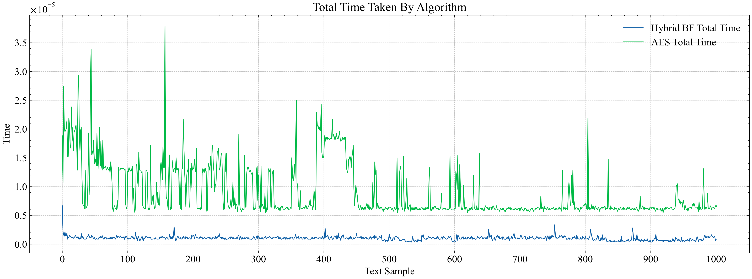
Total Time Over 1000 Messages
We mean by total time the sum of the encode time and the decode time for each message.

Slide 29
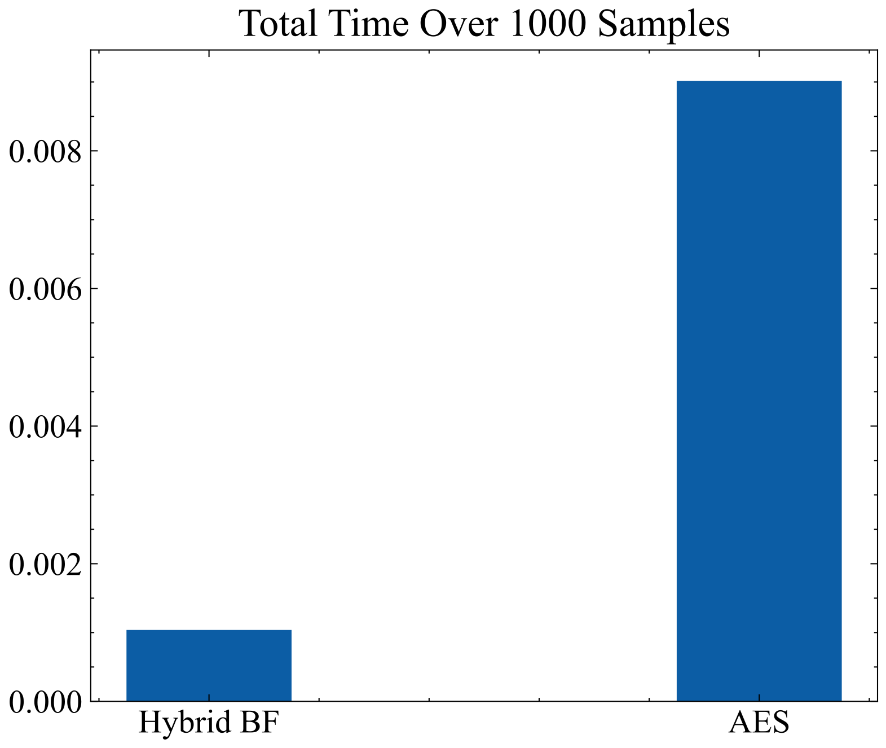
Total Time Sum Over 1000 Messages
HybridBF broved to be 9 faster in total time

Slide 30
Advantages of Faster Encryption Algorithms
Enable real-time encryption of data streams, like encrypting voice calls or video chats.
More widespread adoption and use of encryption.
Make full disk encryption more practical.
Shift cryptography workloads to the client side.

Slide 31
Current Solutions in the Market
There are well-established encryption algorithms available, both symmetric and asymmetric, that have been extensively researched, tested, and proven secure.
Symmetric encryption algorithms like AES.
Asymmetric encryption algorithms like RSA and ECC provide secure key exchange.
Existing solutions also include cryptographic libraries and frameworks that provide implementations of various encryption algorithms.

Slide 32
Methodology
Tools & Libraries:
Python
Pandas
Matplotlib
Numpy
Scienceplots
Scipy
Pycryptodome
Time
String

Slide 33
Current Progress
Our encryption algorithm has been successfully implemented and tested using various messages. Through rigorous comparisons with existing encryption algorithms such as AES, our algorithm has demonstrated significant improvements in terms of speed. Additionally, we have created diverse diagrams showcasing the functionality and features of our messaging web application.

Slide 34
Future Work
During the second phase of our project, we will focus on developing a messaging web application that leverages our high-speed encryption algorithm to ensure secure communication between users. We will also implement a robust approach to encrypting passwords using a secure asymmetric encryption algorithm like RSA within the application's development process.

Slide 35
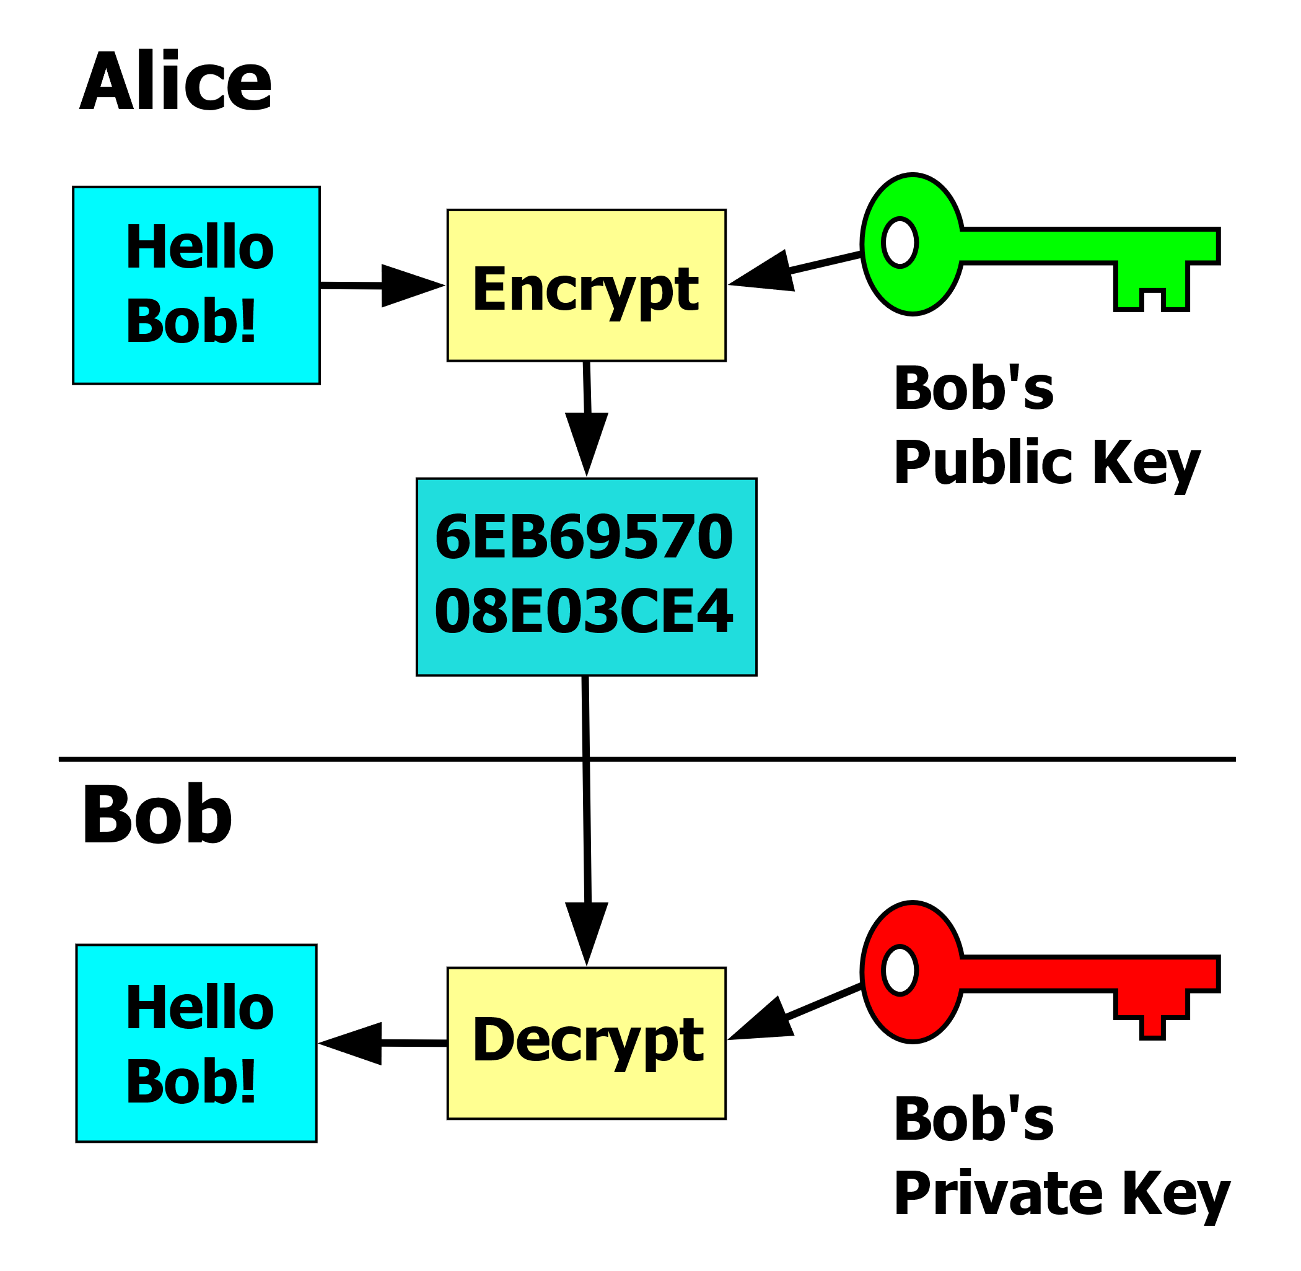
Future Work

Slide 36
THANKS!

